Slide 1
Choosing the Best Districts for us to Live in Warsaw
Jun Jie, Wong
2 Aug 2020

Slide 2
Problem
Different families have different needs and my wife and I are no exception.
With 18 districts to choose from, there will be some that are more suitable for us than others.
No analysis in the market that tells us which boroughs are most suited to us based on venue categories in each borough.

Slide 3
Data and Methodology
Data | Methodology
List of boroughs in Warsaw | Data manually scraped from https://en.wikipedia.org/wiki/Category:Districts_of_Warsaw
Boroughs’ respective latitudes and longitudes | Obtained using Geopy’s Nominatim based on the names of the boroughs
Warsaw map overview of all boroughs | Using Folium to check geographic accuracy
Relationship between boroughs and radius around borough | Using Folium to determine an optimal radius value that is sensible
Venue categories that are within the aforementioned radius | Using Foursquare API by using borough’s latitudes, borough’s longitudes, and optimal radius value as parameters
Filtered venue categories | Filtered manually for venue categories that were relevant to my new apartment location decision
Merged venue categories | Merged manually to group venue categories that were similar to each other before feeding into K-Means algorithm for clustering
Cluster of boroughs | Using K-Means algorithm from SciKit-Learn Clustering

Slide 4
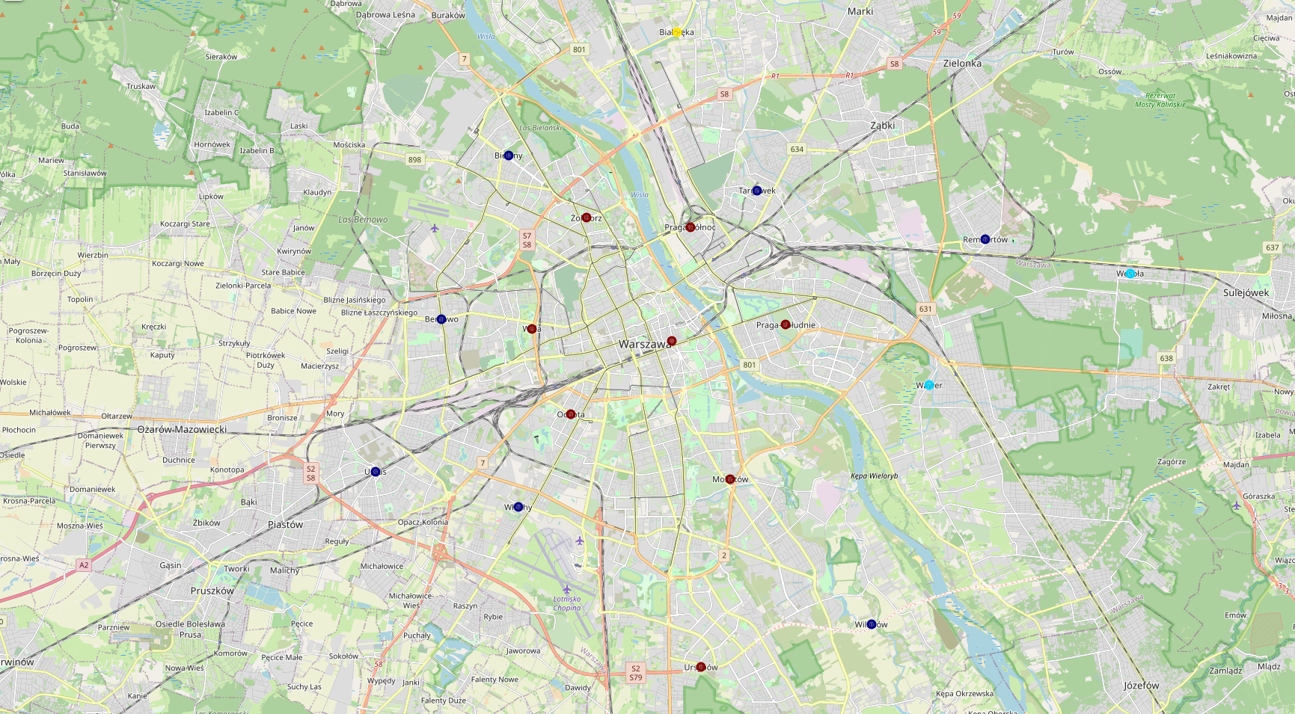
Results: 4 clusters obtained

Slide 5
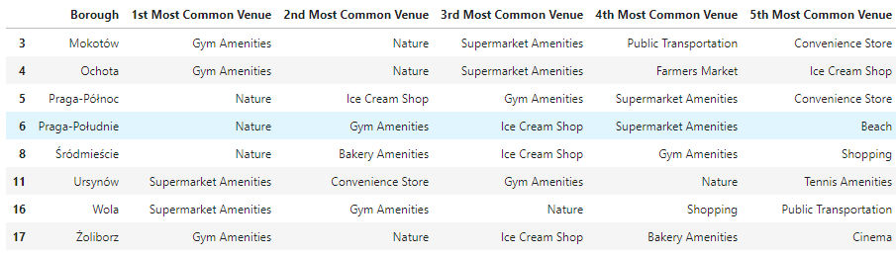
Results and Discussion (1)
Cluster 1 (Dark Red): These boroughs have Nature and Gym Amenities as the most common type of venue. They are most suitable for families who would enjoy nature or the occasional walk in the park and/or working out.

Slide 6
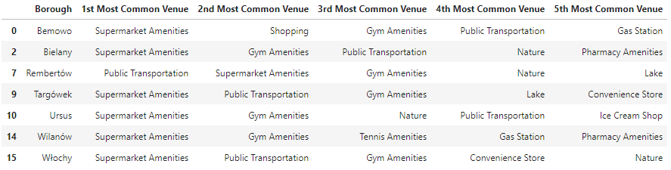
Results and Discussion (2)
Cluster 2 (Dark Blue): These boroughs have supermarkets as the most common type of venue. They are most suitable for families who purchase groceries frequently and with specific items/brands to purchase. These families would probably want to be practical and live close to different supermarkets since different supermarkets carry different groceries at any one time - being in a borough with many supermarkets will almost guarantee the availability of items the families desire.

Slide 7
Results and Discussion (3)
Cluster 3 (Light Blue): These boroughs have public transportation as the most common type of venue. They are most suitable for families who probably do not own a car and would want to be leverage on public transportation such as the bus and metro stations the most.
Cluster 4 (Yellow): With cinema as most common type of venue, this borough is best for families who are frequent movie-goers.

Slide 8
Conclusion
Since my wife and I enjoy nature and we already own a vehicle, the cluster weighted with Nature is our top priority and the cluster weighted with public transportation is our least priority”
Choose boroughs in Cluster 1.
Avoid boroughs in Cluster 3.

